Slide 1
Privacy Policies:
GDPR
This project result has been funded with support from the European Commission. This communication reflects the views only of the author, and the Commission cannot be held responsible for any use which may be made of the information contained therein. Submission Number: 2021-1-ES02-KA220-YOU-000028609

Slide 2
Summary
Introduction
What is the General Data Protection Regulation (GDPR)?
Data Processing Principles of the GDPR
The GDPR's Scope: Who Does it Apply to?
General Requirements of the GDPR
GDPR Fines for Non-Compliance
Conclusion

Slide 3
Introduction
General Data Protection Regulation (GDPR) For the elaboration of privacy policies of companies operating in the European Union, it is necessary to refer to the General Data Protection Regulation (GDPR). This is EU law that aims to give EU residents more control over their data. Under this legislation, organizations that handle data of EU residents have to comply with certain data and privacy rules. One of the main objectives and requirements of the GDPR is to keep EU residents informed of how companies collect, use, share, protect and process their personal data.

Slide 4
What is the General Data Protection Regulation?
Moderate data protection laws across all 28 EU member states into one centralized source, reinforces individual privacy rights regarding personal data protection, and imposes fines and other punishments on violators.

Slide 5
Data Processing Principles of the GDPR:
Under the GDPR, if you process data in the EU, you must observe the
seven data protection and accountability principles listed in Article 5 of
the regulation. Briefly, the principles are as follows.
Lawfulness, Fairness, and Transparency

Slide 6
Personal data must be:
Processed legally by identifying one of the lawful bases for doing so,
Handled fairly and appropriately, and
Managed in a transparent way
Purpose Limitation
You must process people's personal data for the exact lawful purpose or decided upon during its collection.
Here's how Twitter satisfies this requirement in its Data Processing
Addendum:
Twitter shall not retain, use or disclose your Data for any purposes
other than for the specific purpose of performing the eservices specified in this DPA or any other agreement between You and Twitter;

Slide 7
Data Minimization
The data minimization principle states that you should only obtain and
process data that you strictly need for the pre-established purposes and no
more. For example, you don't need a person's date of birth to send email newsletters.
Accuracy
Personal information in your possession must be kept accurate and regularly
updated. Storage Limitation
You must delete personal data when it's no longer necessary for the
legitimate purpose specified during its collection. However, you may hold on
to personal data for longer periods if you process data for:
Archiving purposes in the interest of the public,
Historical or scientific research, or
Statistical purposes

Slide 8
The GDPR's Scope: Who Does it Apply to?
The GDPR, unlike its predecessor, is not only exclusive to EU individuals and companies, but organizations outside the region may also be subject to the regulation in certain instances.

Slide 9
To find out if you fall under the GDPR's scope, consider the following
questions:
1. Do you collect personal information or monitor the behaviour of EU citizens?
For example, if you have EU users sign up on your website or track IP addresses or cookies of visitors from the EU, then the GDPR applies to you regardless of your location.
Moreover, the stringency of the law may depend on the type of information you collect. Recall that sensitive personal data is held to stricter regulations than personal data.
2. Do you offer goods or services to EU citizens?
If you target EU citizens with the hope of selling them your products or services (physical or online), the GDPR applies to you regardless of your location. To put this in context, if your website features pricing in euros or ads in French, it targets EU citizens and will, therefore, be subject to the regulation.

Slide 10
Exceptions to the GDPR
Under the GDPR, there are two significant exceptions to note.
Firstly, it is for companies with less than 250 employees. Organizations in this category are not fully exempt, but they enjoy a more lenient coverage under the regulation.
Secondly, the GDPR does not apply to individuals or companies involved in purely "personal or household activities". Its scope only covers "commercial or professional activities."
However, such companies must fully comply with the GDPR when:
Their processing activities may risk the rights and freedoms of data
subjects
They process sensitive personal data or process data frequently, or
They process a special data category relating to "criminal convictions
and of ences"

Slide 11
However, such companies must fully comply with the GDPR when:
Their processing activities may risk the rights and freedoms of data
subjects
They process sensitive personal data or process data frequently, or
They process a special data category relating to "criminal convictions
and of ences"

Slide 12
Lawful Basis for Processing Personal Data Under the GDPR
Before attempting to process an individual's personal data, you must identify
one of the lawful bases under the GDPR to justify doing so. Briefly, they are
as follows:
1. Consent
If you process under the lawful basis of consent, your processing activities
are considered legal only after getting clear, affirmative consent from your
data subjects. This lawful basis promotes the GDPR mission to give more
control to data subjects.

Slide 13
2. Contract
You may need to process personal data to execute or enter into a contract
with data subjects. For example, a customer may sign up for a trial before a
contract, which may require you to collect their personal data (e.g., contact
information).
3. Legal Obligation
Processing a person's data without consent is allowed when the law compels
you to do so. For example, you may have to disclose a user's personal
information to aid federal authorities in a criminal investigation.
4. Vital Interests
Processing a person's data is considered lawful if their life depends on it, and
they can't provide consent. This legal basis may be more prominent in the
medical industry.
5. Public Task
Processing personal data may be crucial to perform a duty in the public's
interest or the exercise of official authority.

Slide 14
6. Legitimate Interests
Companies with genuine, legitimate reasons may process data without
consent as long as it does not interfere with the rights or freedoms of data
subjects. Examples include:
Information and network security
Fraud prevention
Indicating dangers to general safety

Slide 15
General Requirements of the GDPR
The GDPR has provided both controllers and processors with several
new requirements they must observe and implement under the regulation.
Briefly, they include the following.
Have a GDPR-Compliant Privacy Policy
The GDPR requires a number of disclosures. The best way to make the disclosures and keep your users informed of important facts is to have a Privacy Policy that complies with GDPR requirements. These rights should be prominently displayed and easily accessible for users’ convenience, typically within your Privacy Policy
Strengthen Individual Rights Under the GDPR
As an organization subject to the regulation, you must observe and help exercise the individual user rights under the GDPR. They include:

Slide 16
Right to be informed - Notify users about how you obtain and process their data in a brief, intelligible, and easily accessible form.
Right of access - Allow users to obtain information about how you use, store, or disclose their data.
Right of rectification - Let users correct inaccurate information about them displayed in your records.
Right to erasure - Promptly delete users' data at their request.
Right to restrict processing - Stop processing users' data at their request.
Right to data portability - Allow users to transfer a copy of their data to another company.
Right to object - In certain instances, users can object to the processing of their personal data.
Rights related to automated decisions - Protect users from automated decisions by granting a review when requested.
These rights should be prominently displayed and easily accessible for users'
convenience, typically within your Privacy Policy.

Slide 17
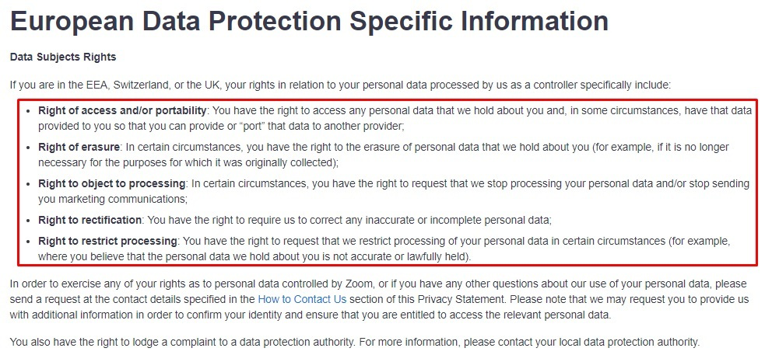
For example, here's how Zoom displays this information in its Privacy
Statement:

Slide 18
Implement Data Protection Impact Assessments
A Data Protection Impact Assessment (DPIA) helps evaluate how your
processing activities may affect the protection of personal data.
You must observe this requirement if your processing operations are likely
to expose the rights and freedoms of users to high risk.
Such cases include when you:
Process a considerable amount of data that could significantly affect a lot of users
Process a high volume of sensitive personal data
Utilize the latest technologies to process data, or
Process data in order to profile people

Slide 19
Designate a Data Protection Officer
A data protection officer (DPO) supervises an organization's data protection
strategy. DPOs are appointed to educate and advise management about
GDPR compliance as well as address the privacy concerns of users.

Slide 20
Designating a DPO is not optional in certain instances. According to the
regulation, you must appoint a DPO if you:
Are a public authority (e.g., a state university),
Often process data or monitor data subjects on a large scale, or
Process a substantial amount of sensitive personal data or data relating to criminal offences and convictions

Slide 21
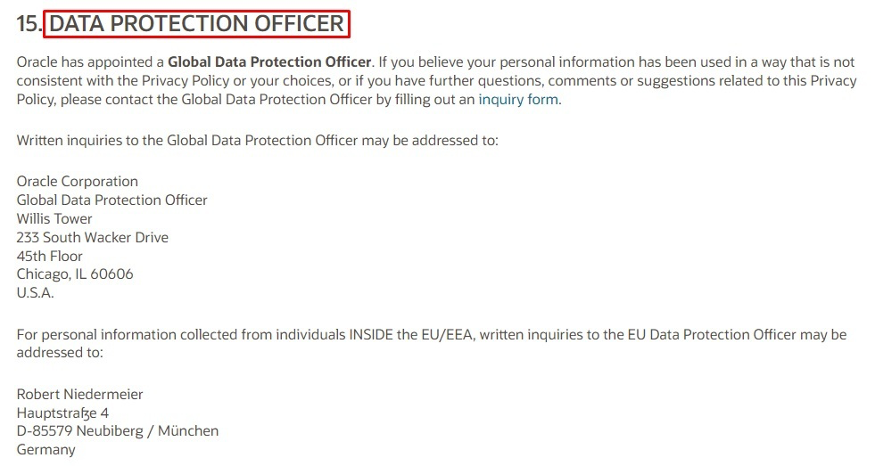
In addition, your DPO's name and contact information should be publicly displayed in your Privacy Policy.
Here's how Oracle satisfies this requirement in its Privacy Policy:

Slide 22
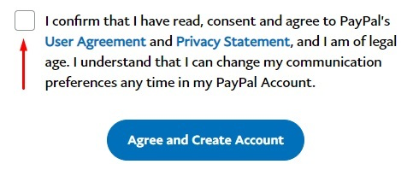
Obtain Consent When Needed
Consent is now more deeply regulated under the GDPR. According to the
law, consent must be clear, specific, unambiguous, and characterized by an
approving action.
To get explicit consent, you can make users tick a box that states that by ticking the box, they agree with your policies. Additionally, consent must be easy to withdraw and given only by users over the age of 13 or else approved by a parent.
Here's how PayPal obtains explicit consent from its users before creating
accounts:

Slide 23
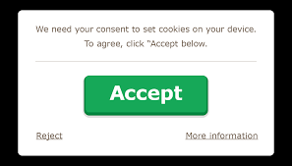
Consent is also required before using website cookies that track EU citizens.
Engine Yard complies appropriately with this requirement by giving its users options regarding cookies, as shown below:

Slide 24
Implement Privacy by Design
Privacy by Design is a concept that requires companies to implement data privacy principles at the onset of a new product or process (i.e., by default).
Seven fundamental principles must be observed under this requirement to reduce data collection and improve security. There are:
Strive to prevent crises rather than seek solutions
Value privacy as the default setting
Incorporate privacy into the design
The privacy should be completely functional
Protect data throughout its lifecycle
Embrace transparency
Prioritize the protection of users' information

Slide 25
Notify of Data Breaches
Under the GDPR, a personal data breach is defined as:
"A breach of security leading to the accidental or unlawful destruction, loss, alteration, unauthorized disclosure of, or access to, personal data transmitted, stored or otherwise processed"
In the event a data breach occurs, you must inform the proper supervising authority within seventy-two hours after discovering it. You must also inform the concerned data subjects if the breach may threaten their rights and freedoms. Your notice should contain the following information:
The nature of the breach
The name and contact details of the DPO or similar information
The possible ramifications
The recommended steps to take in order to manage the breach

Slide 26
Protect Data During Data Transfers
Under the GDPR, organizations must take additional steps to protect personal data during transfers to third countries (i.e., countries outside the EU that handle personal data).

Slide 27
GDPR Fines for Non-Compliance
The GDPR fines for non-compliance are one of the steepest in the
world right now, running into tens of millions of dollars. To establish
suitable penalties for violators, the GDPR has categorized the
stringency of infringements into two tiers.

Slide 28
Tier 1 infringements are characterized by breaches of controller and
processor duties, monitoring bodies, and certification bodies.
GDPR fines for tier 1 violations can run up to 2% of the company's
annual global turnover from the previous financial year or €10 million
(whichever is higher).
On the other hand, Tier 2 infringements are characterized by
violations of data processing principles, consent, individual rights
under the GDPR, etc.
Fines for such violations can run up to 4% of the company's annual global
turnover from the previous financial year or €20 million (whichever is
higher).

Slide 29
Summary
Since its introduction, the GDPR has completely transformed the privacy game for both data subjects and organizations alike. Taking actions now to comply not only protects your organization from the
stringent penalties of the regulation but also depicts top-notch industry standards to reassure users of their personal data security. Here are the key takeaways to ensure GDPR compliance:

Slide 30
Observe the GDPR's data processing principles
Process data only after identifying one of the lawful bases
Pay attention to the individual rights of users and help exercise them
Get clear, affirmative consent to process personal data and explicit
consent for sensitive data
Provide and maintain a GDPR-compliant Privacy Policy
Appoint a DPO if required by law and provide the contact information
in your Privacy Policy
Stay up-to-date on privacy trends to ensure full compliance

Slide 31
Conclusion
There is virtually no doubt that the GDPR represents a milestone in
enabling users to achieve higher control over their (relatively broadly
defined) personal data. However, the introduction of the GDPR has
also stimulated a wide range of discussions among data protection
authorities, firms, industry initiatives and consumer advocates on the
implications of complying with the GDPR and how best to achieve
such compliance—as well as more fundamental questions regarding
what the true value of user privacy is, and how best to provide users
with the optimal level of privacy.

Slide 32
Thank you!!!

